Slide 1

Otterbein Nursing Faculty management website
Henry Dyer, Eric Terranova, Luis Garcia, Suraj Kopparam

Slide 2
Client Requirements
Web-based tool for managing compliance information for the Otterbein Nursing Department
Tool needs to track data for employees who are adjunct clinical instructors
This includes basic faculty info, degrees, courses, section info, clinical sites, and documents
Front-facing tool for creating, editing, and deleting database entries
Lists for filtering, searching, and sorting through entries of each type

Slide 3
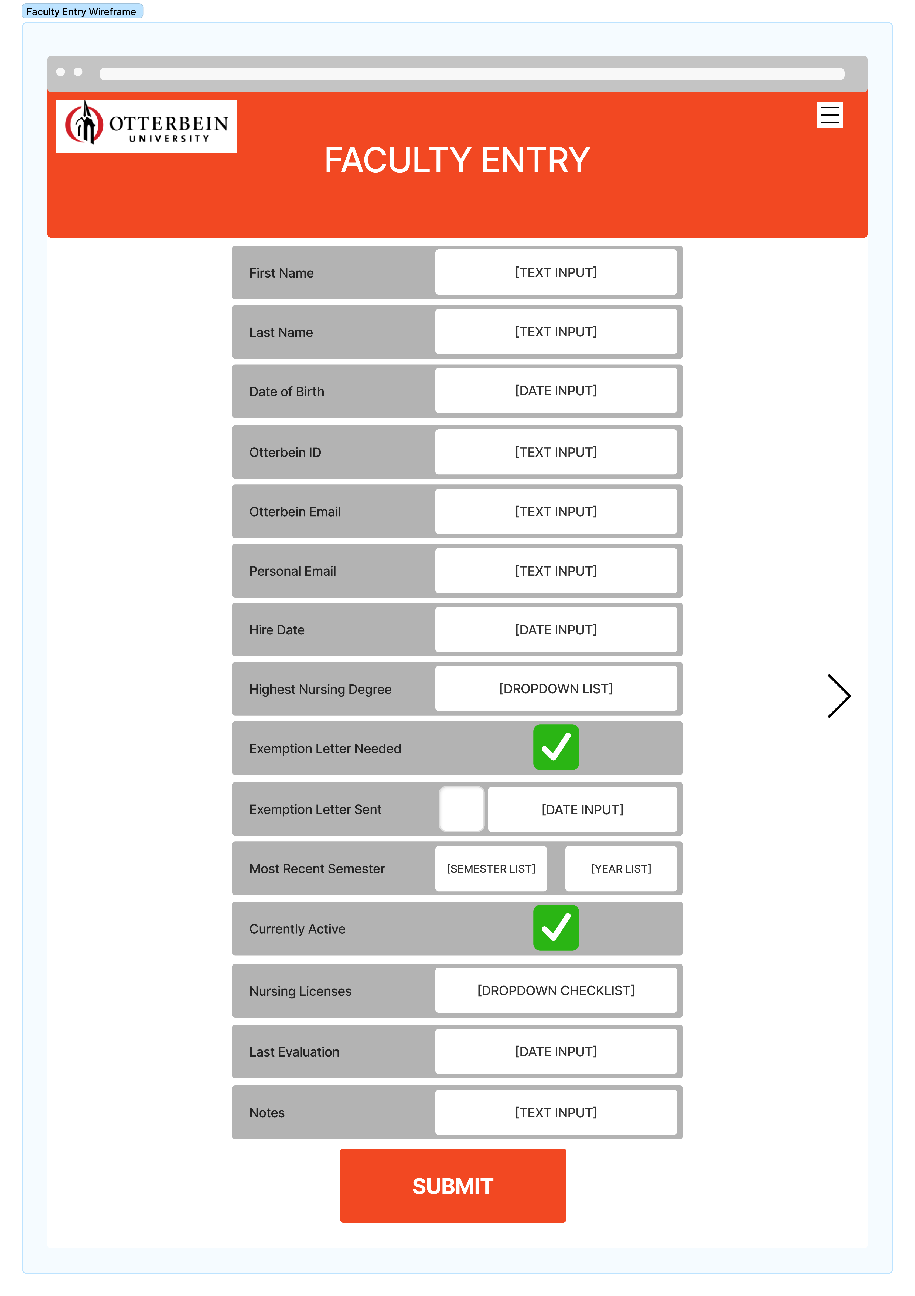
Initial Solutions
Our initial product backlog consisted of tasks such as webpage setup, database design & implementation, login system, interfaces for creating & modifying entries, and data lists
We decided on the React framework to build our webpage, and used a MySQL database managed through phpMyAdmin
Created wireframes to map out form submission pages and individual profile pages

Slide 4
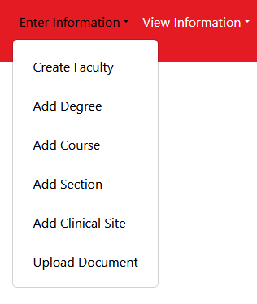
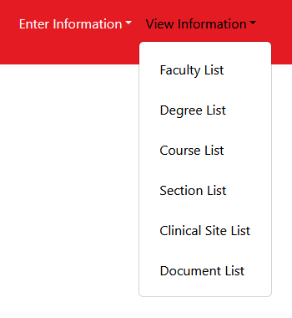
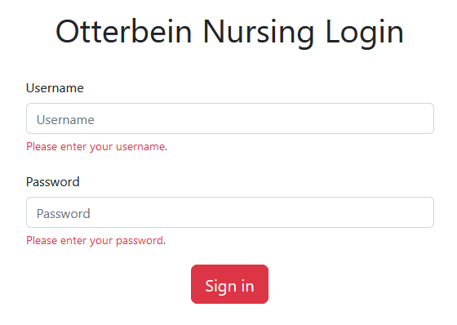
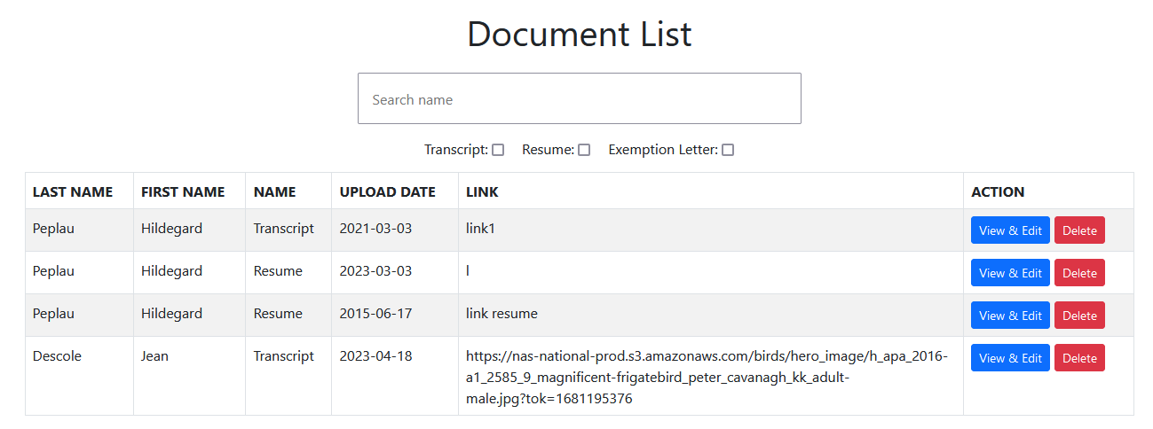
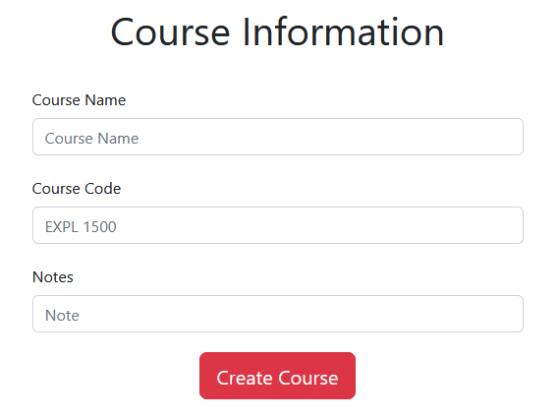
Final Product

Slide 5
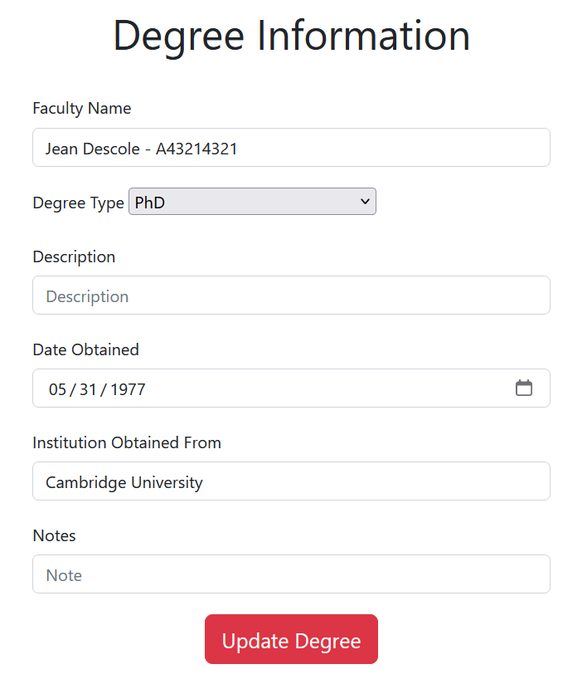
Notable Features
Robust and easy-to-use forms for entering relevant information
Create, view, edit, and delete data—all with a few clicks
Filtering and search system for finding data easily
Login system for privacy and security

Slide 6
Product Demo
https://nursing.otterbein.engineering

